Slide 1
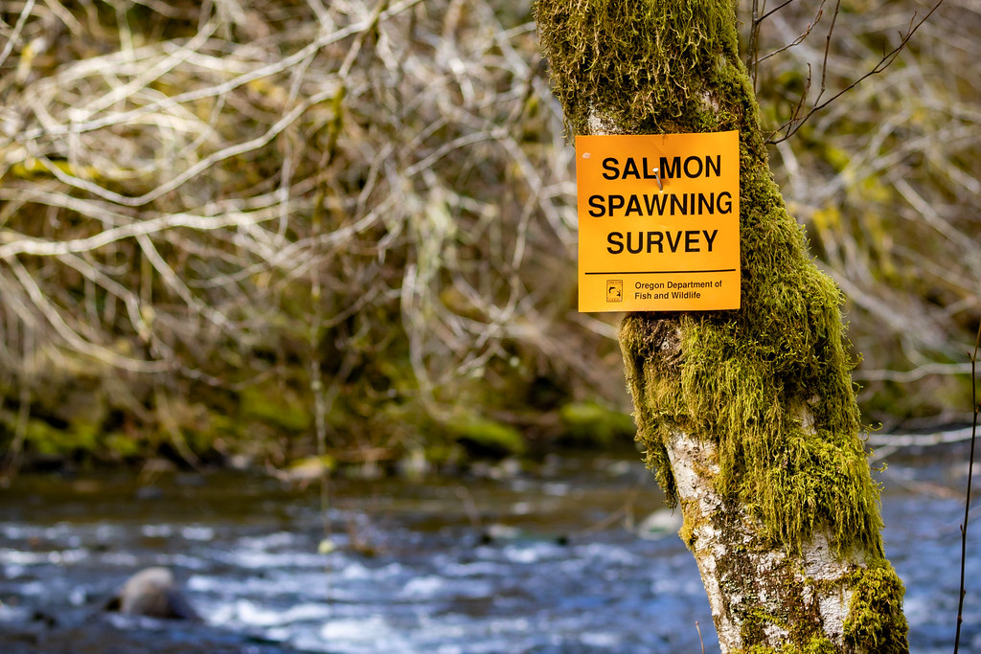
Understanding precision and directional bias of fisheries abundance estimates across 24 commonly used salmonid survey methods

Slide 2
Understanding precision and directional bias of fisheries abundance estimates across 24 commonly used salmonid survey methods

Slide 3
Background

Slide 4
Why salmon are important?

Slide 5
Why salmon are important?
Ecologically crucial species

Slide 6
Why salmon are important?
Ecologically crucial species
Marine nutrients found in trees in central Idaho

Slide 7
Why salmon are important?
Ecologically crucial species
Marine nutrients found in trees in central Idaho
Cultural significance

Slide 8
Why salmon are important?
Ecologically crucial species
Marine nutrients found in trees in central Idaho
Cultural significance
Central to Indigenous ways of life and cultural identity

Slide 9
Why salmon are important?
Ecologically crucial species
Marine nutrients found in trees in central Idaho
Cultural significance
Central to Indigenous ways of life and cultural identity
Commercial significance

Slide 10
Why salmon are important?
Ecologically crucial species
Marine nutrients found in trees in central Idaho
Cultural significance
Central to Indigenous ways of life and cultural identity
Commercial significance
$7.2 million in OR in 2024

Slide 11
How are salmon doing?

Slide 12
How are salmon doing?
Not great in the lower 48

Slide 13
How are salmon doing?
Not great in the lower 48
28 population groups of salmon/trout listed as endangered or threatened under ESA

Slide 14
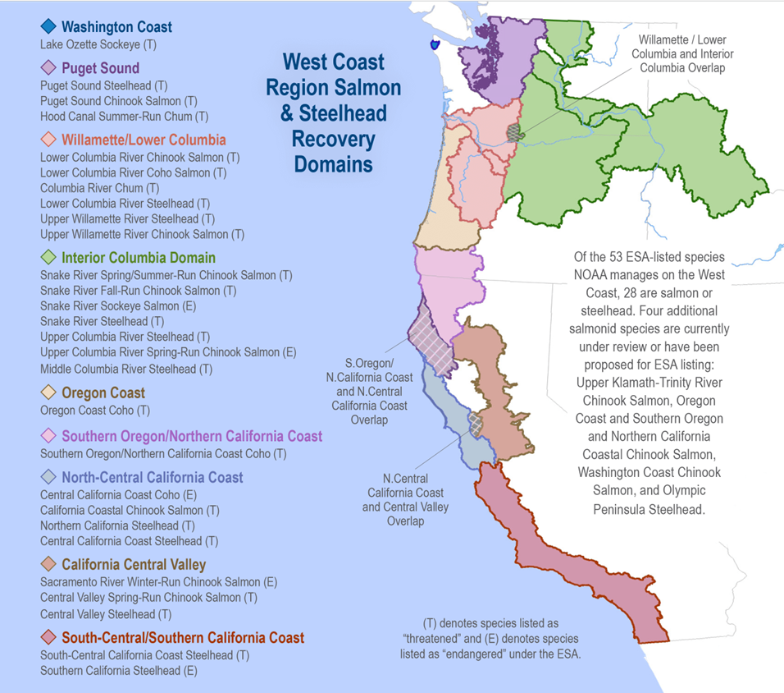

Slide 15
How are salmon doing?
Not great in the lower 48
28 population groups of salmon/trout listed as endangered or threatened under ESA
13 of these in Columbia Basin

Slide 16
How are salmon doing?
Not great in the lower 48
28 population groups of salmon/trout listed as endangered or threatened under ESA
13 of these in Columbia Basin
Despite restoration efforts

Slide 17
How are salmon doing?
Not great in the lower 48
28 population groups of salmon/trout listed as endangered or threatened under ESA
13 of these in Columbia Basin
Despite restoration efforts
$ 9 billion spent in Columbia Basin since 1990s

Slide 18
How do we know how salmon are doing?

Slide 19
How do we know how salmon are doing?
We count them!

Slide 20
How do we know how salmon are doing?
We count them!
Well, we count some of them

Slide 21
How do we know how salmon are doing?
We count them!
Well, we count some of them and make educated guesses about the rest…

Slide 22
How do we know how salmon are doing?
We count them!
Well, we count some of them and make educated guesses about the rest…
Using a variety of survey methods and monitoring techniques

Slide 23
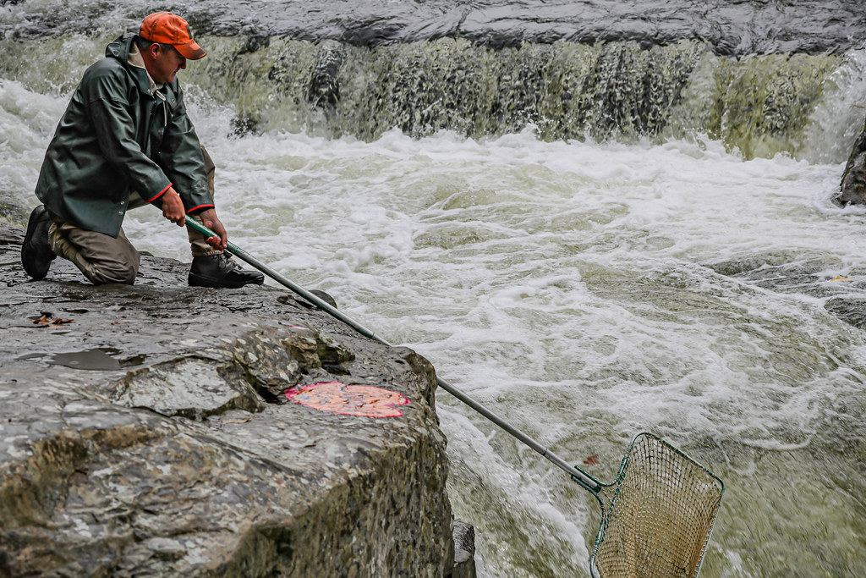
How do we know how salmon are doing?

Slide 24
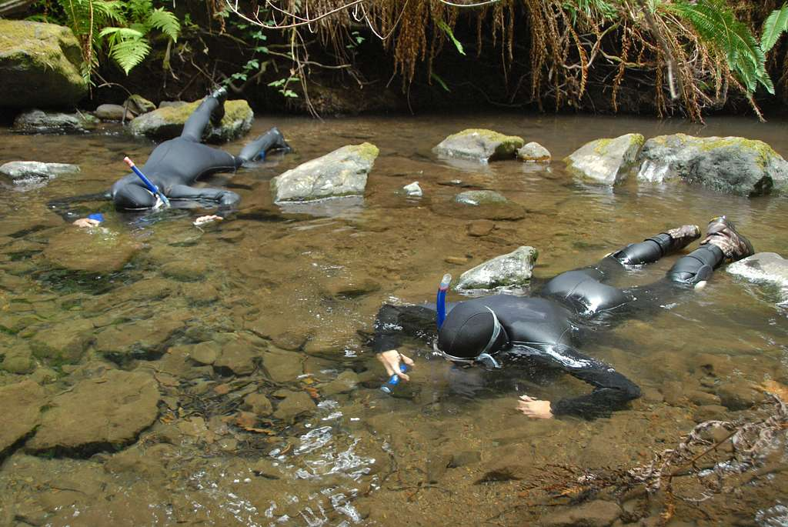
How do we know how salmon are doing?

Slide 25
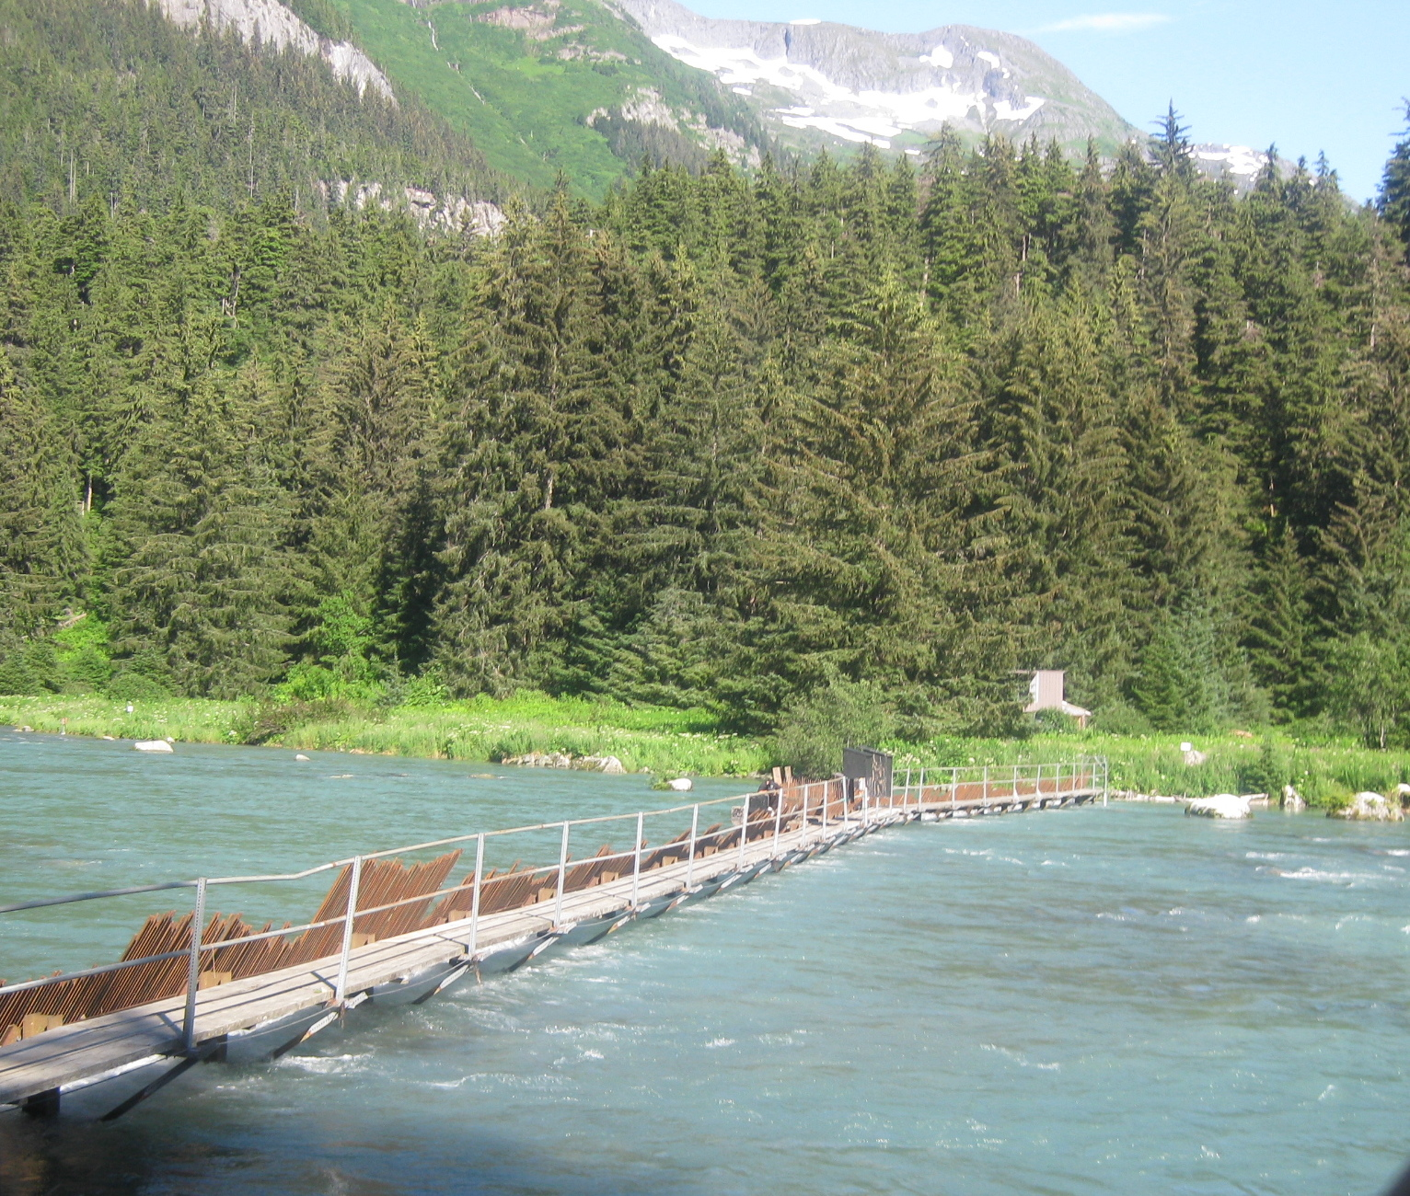
How do we know how salmon are doing?

Slide 26
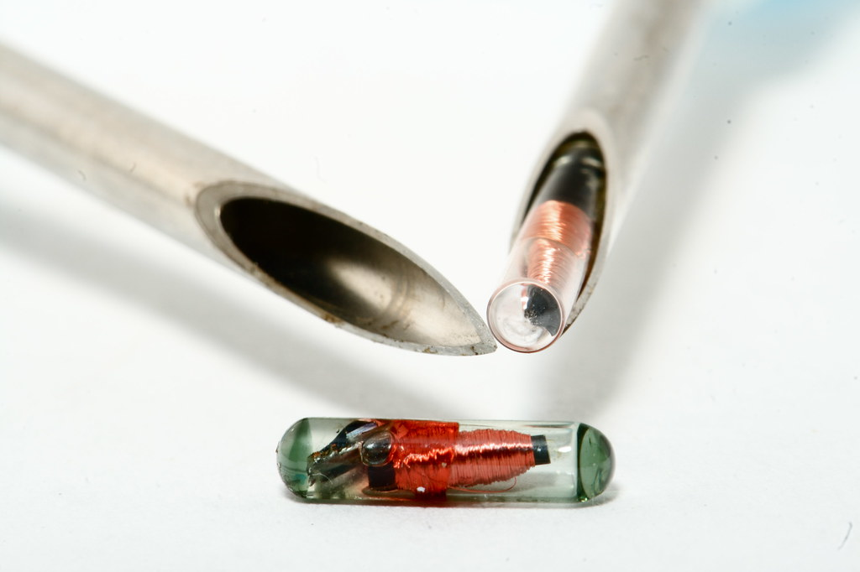
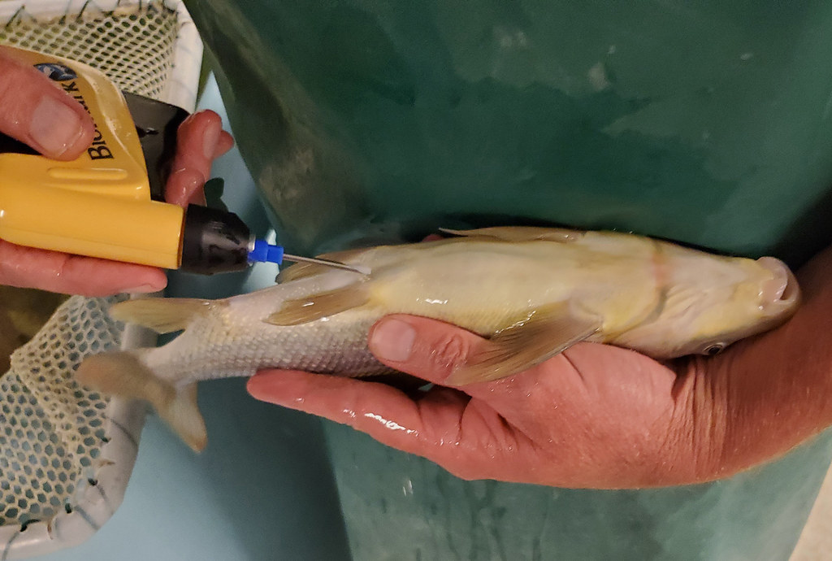
How do we know how salmon are doing?

Slide 27

How do we know how salmon are doing?

Slide 28
How do we know how salmon are doing?

Slide 29
Research goal: Evaluate salmon survey methods for precision and directional bias

Slide 30
Data

Slide 31
Data
Spawning salmon estimates in Oregon
3 species: Chinook, coho, steelhead
68 populations
Annual observations, 1980 to 2022
31 survey methods

Slide 32
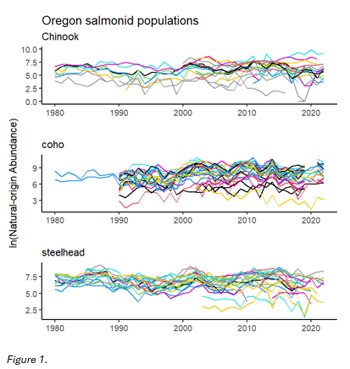
Data – abundance estimates

Slide 33
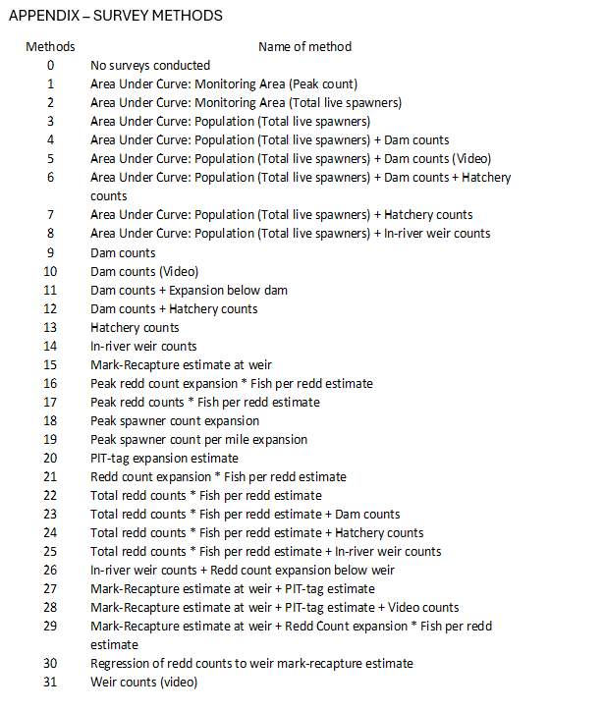
Data – survey methods

Slide 34
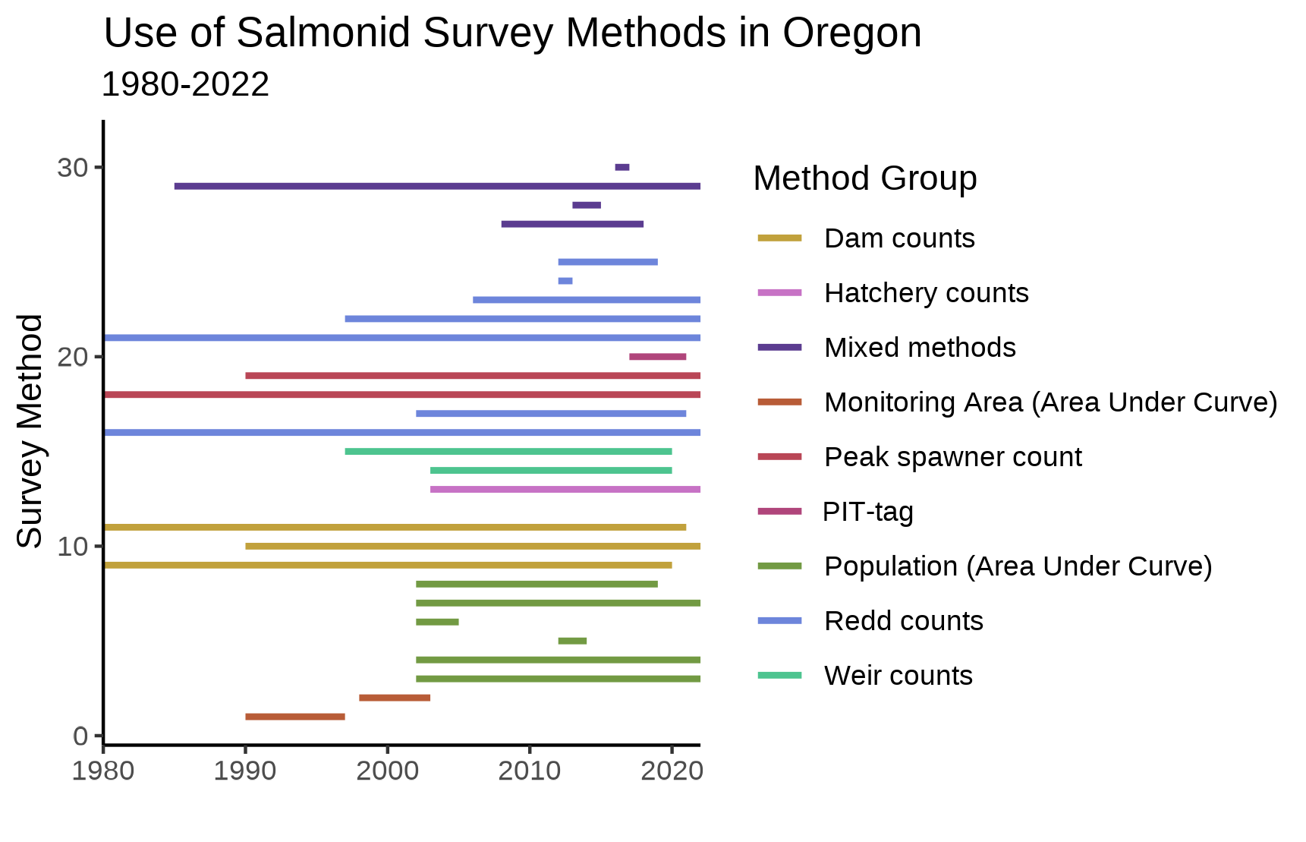
Data – survey methods

Slide 35
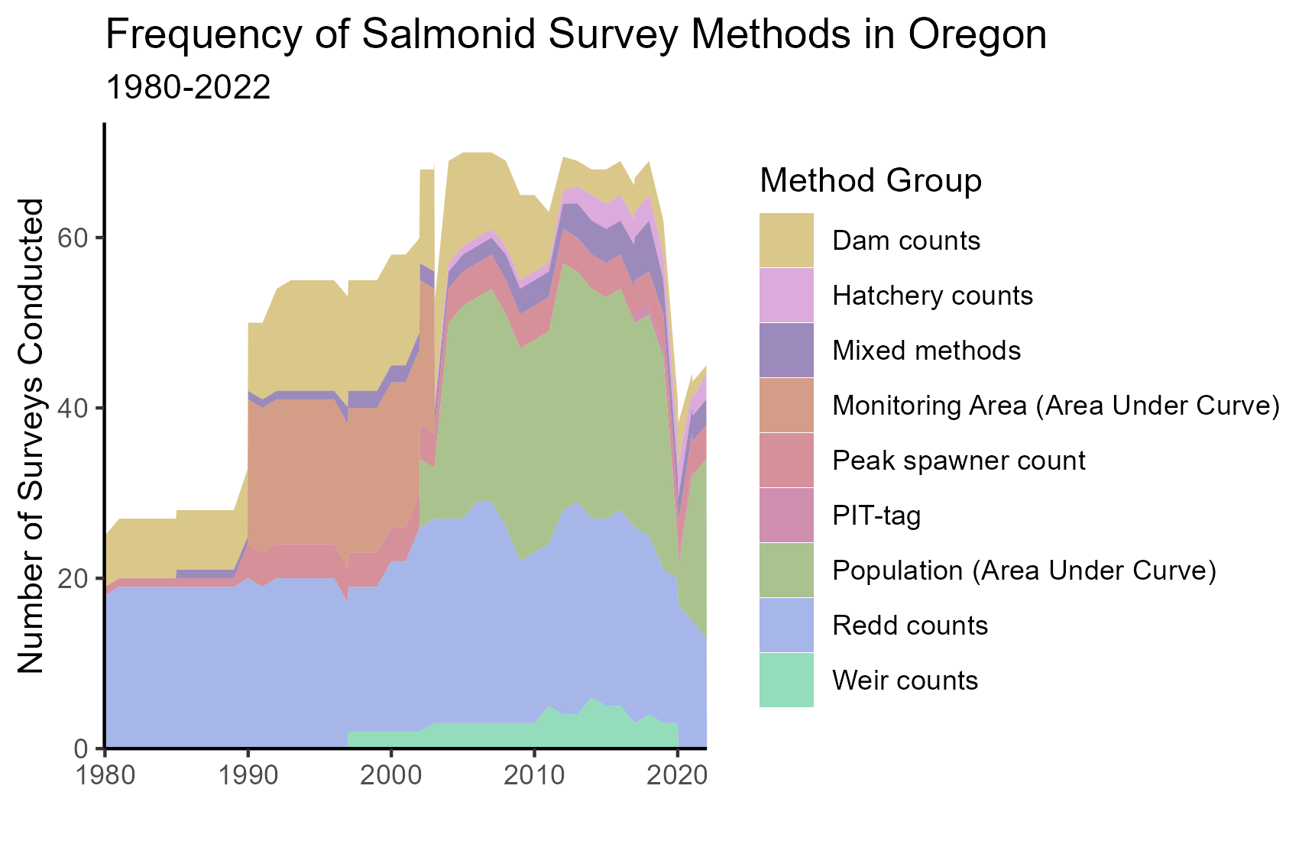
Data – survey methods

Slide 36
Methods

Slide 37
Modeling approach
Multivariate AutoRegressive State Space models
(MARSS)

Slide 38
Modeling approach
Multivariate AutoRegressive State Space models
(MARSS)
x_{t} = Bx_{t−1} + u + w_{t}, where w_{t}∼MVN(0,Q)
y_{t} = Zx_{t} + a + v_{t}, where v_{t}∼MVN(0,R)

Slide 39
Modeling approach
MARSS models
Observation equation
x_{t} = Bx_{t−1} + u + w_{t}, where w_{t}∼MVN(0,Q)
y_{t} = Zx_{t} + a + v_{t}, where v_{t}∼MVN(0,R)

Slide 40
Modeling approach
MARSS models
Underlying state/process equation
x_{t} = Bx_{t−1} + u + w_{t}, where w_{t}∼MVN(0,Q)
y_{t} = Zx_{t} + a + v_{t}, where v_{t}∼MVN(0,R)

Slide 41
Modeling approach
MARSS models
x_{t} = Bx_{t−1} + u + w_{t}, where w_{t}∼MVN(0,Q)
y_{t} = Zx_{t} + a + v_{t}, where v_{t}∼MVN(0,R)
Distinguishes variance due to observation error from variation in underlying state

Slide 42
Modeling approach
What am I concerned with?
x_{t} = Bx_{t−1} + u + w_{t}, where w_{t}∼MVN(0,Q)
y_{t} = Zx_{t} + a + v_{t}, where v_{t}∼MVN(0,R)

Slide 43
Modeling approach
What am I concerned with?
x_{t} = Bx_{t−1} + u + w_{t}, where w_{t}∼MVN(0,Q)
y_{t} = Zx_{t} + a + v_{t}, where v_{t}∼MVN(0,R)
I am interested in observation bias (a) and observation variance (R)

Slide 44
Results

Slide 45
Results
Precision (R) and bias (a) terms estimated for 19 survey methods

Slide 46
Results
Precision (R) and bias (a) terms estimated for 19 survey methods
Not every method evaluated for every species

Slide 47
Results
Precision (R) and bias (a) terms estimated for 19 survey methods
Not every method evaluated for every species
12 methods with very few data points in the time series

Slide 48
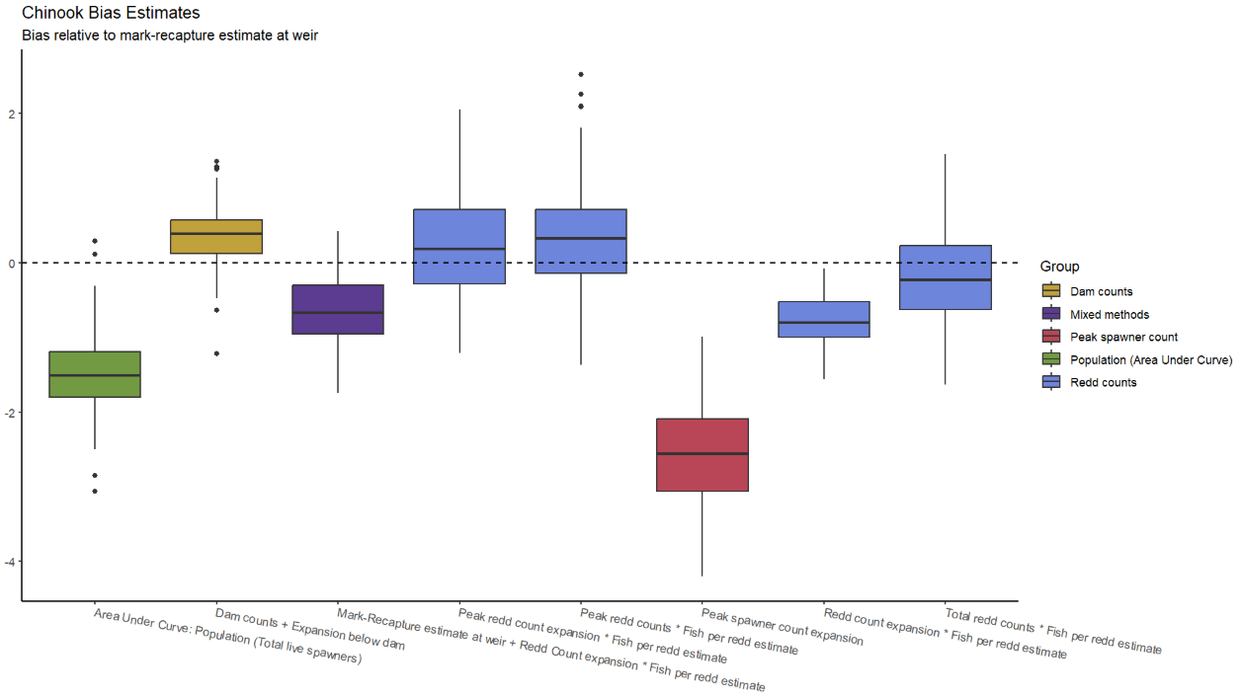
Results - Chinook

Slide 49
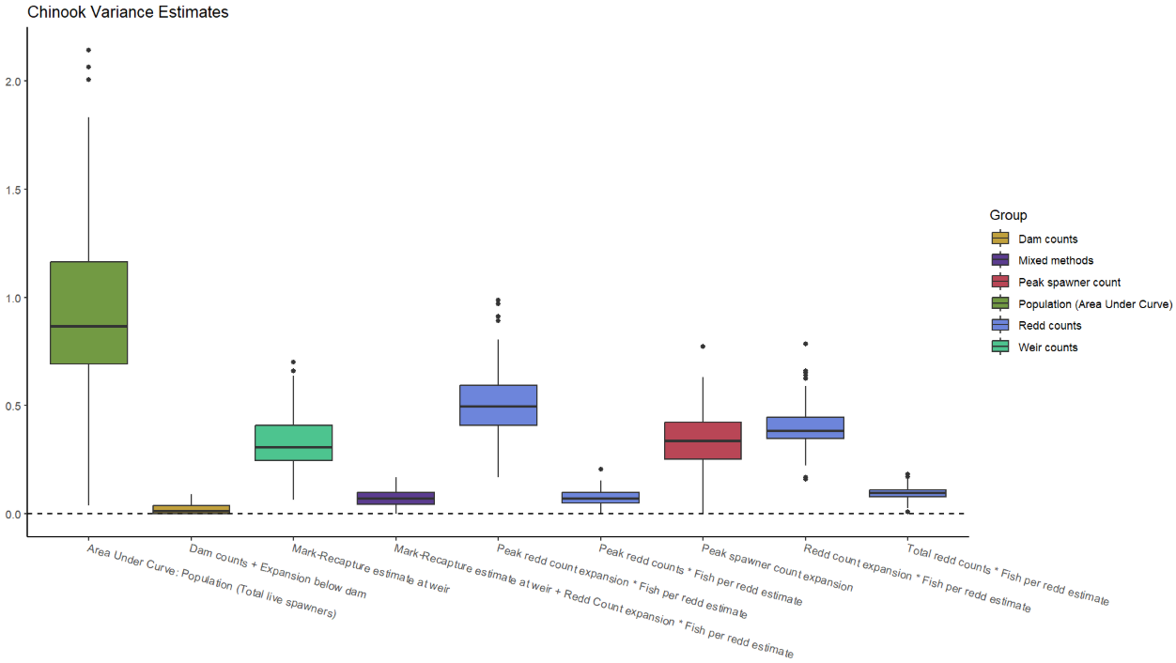
Results - Chinook

Slide 50
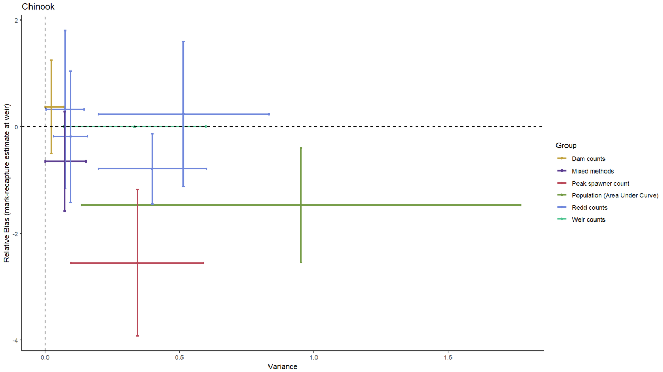
Results - Chinook

Slide 51
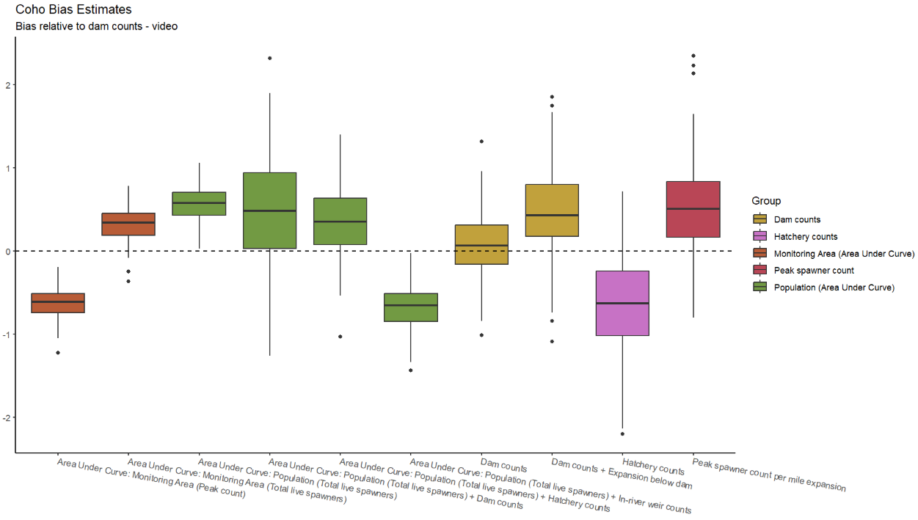
Results - coho

Slide 52
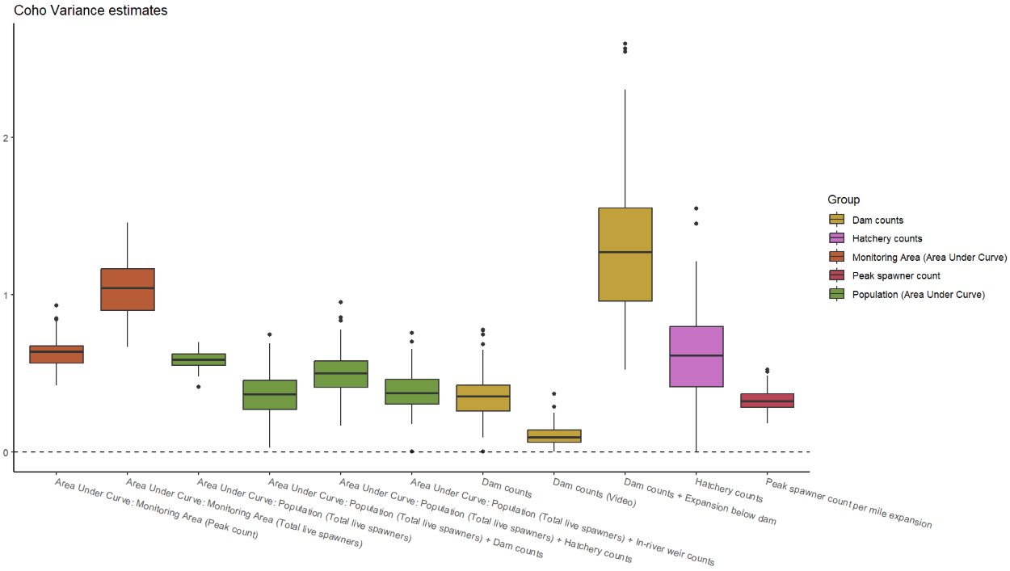
Results - coho

Slide 53
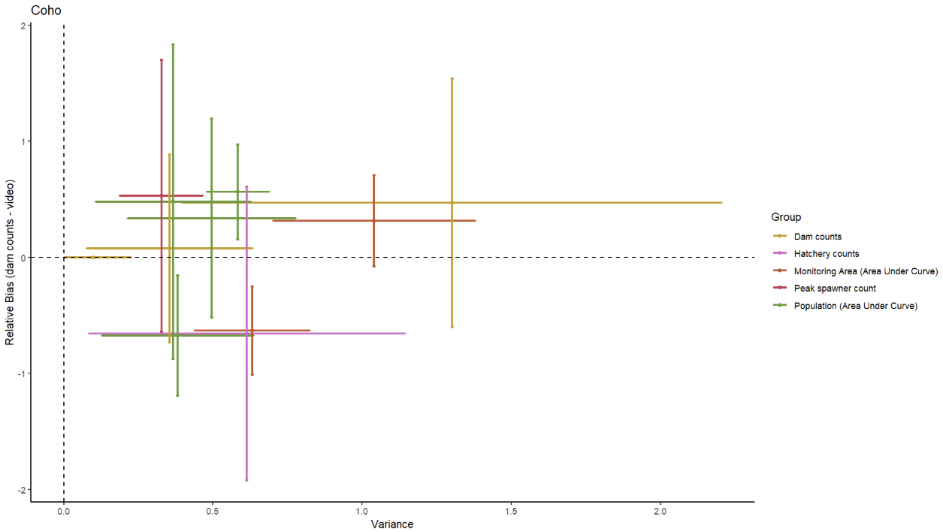
Results - coho

Slide 54
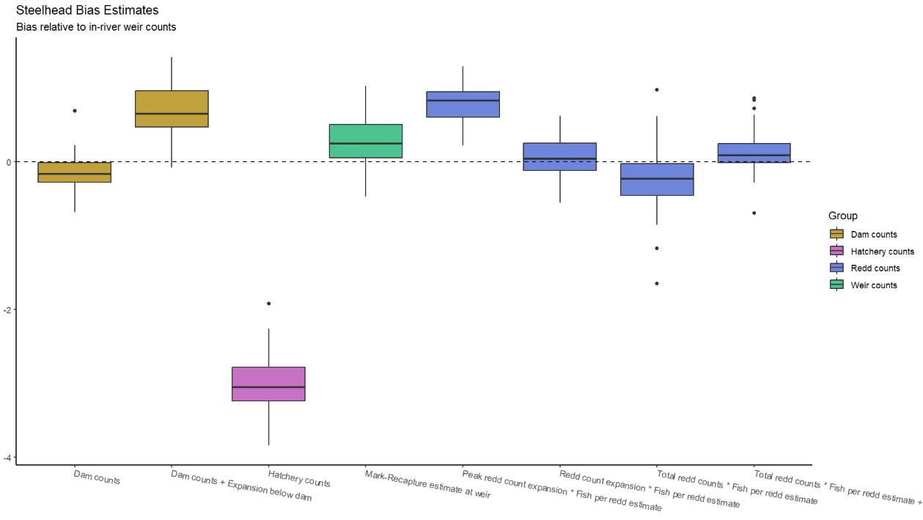
Results - steelhead

Slide 55
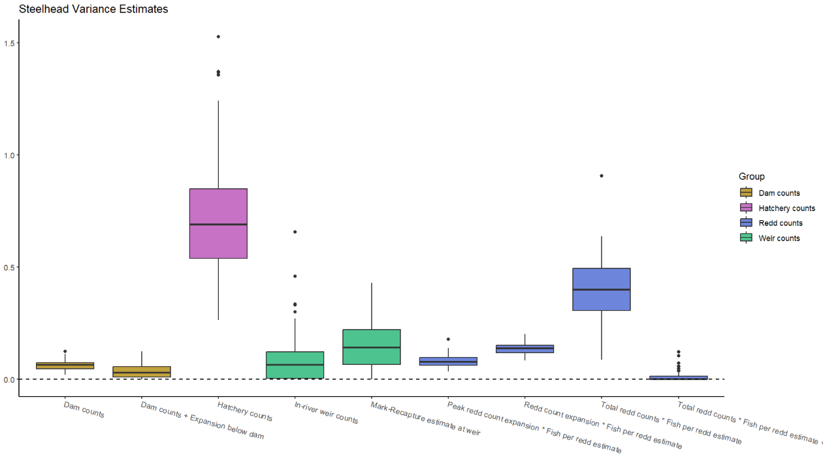
Results - steelhead

Slide 56
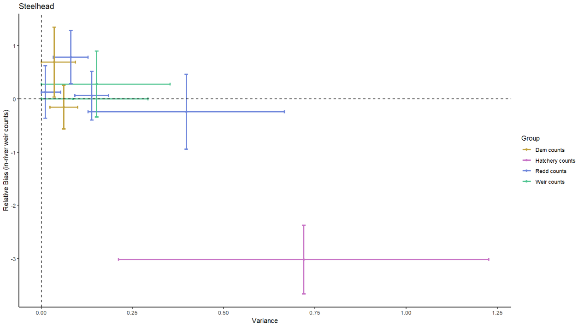
Results - steelhead

Slide 57
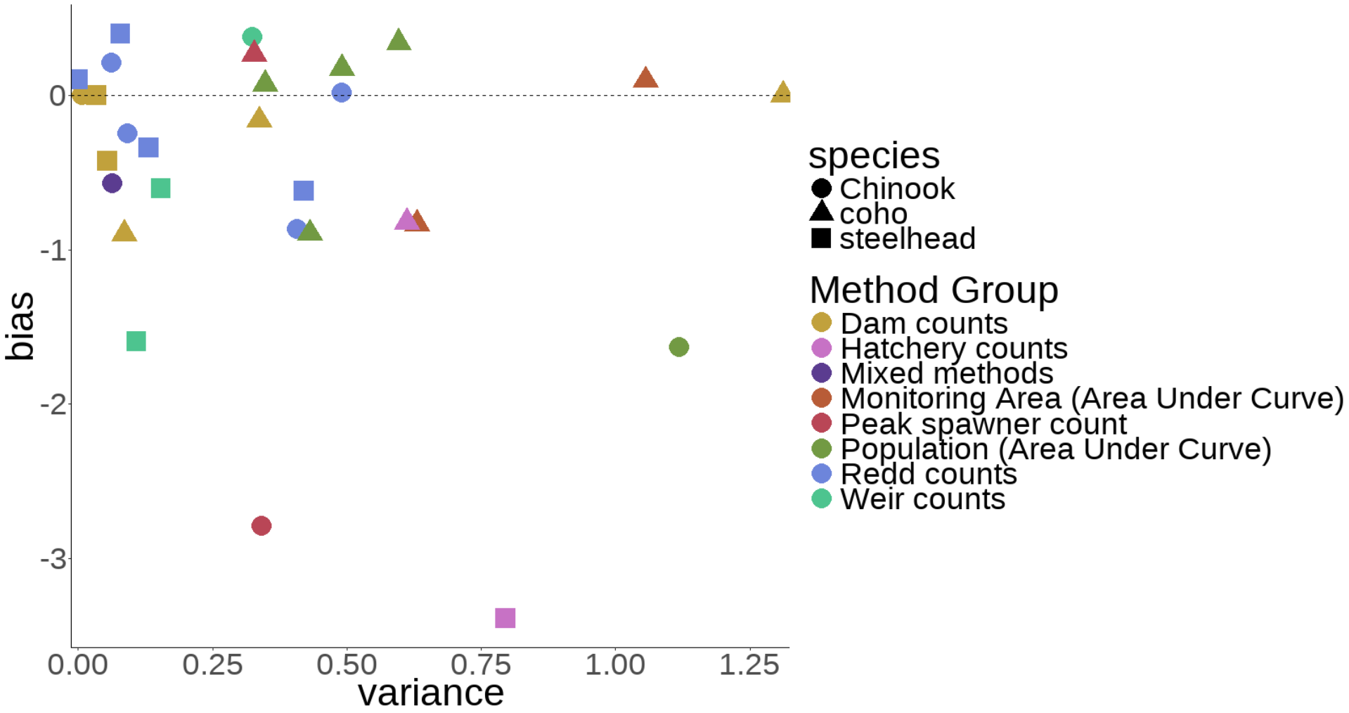
Results – all species
Reference method: Dam counts + Expansion below dam, a=0

Slide 58
Results
The same survey method can have very different levels of precision between species

Slide 59
Results
The same survey method can have very different levels of precision between species
AUC population estimates and peak spawner counts tend to be at extremes in terms of bias

Slide 60
Results
Coho generally seem to be more difficult to count precisely than Chinook or steelhead

Slide 61
Results
Coho generally seem to be more difficult to count precisely than Chinook or steelhead
Dam counts, weir counts, and redd counts tend to be most precise

Slide 62
Discussion & Next Steps

Slide 63
Discussion
Wide variety of survey methods available to biologists

Slide 64
Discussion
Wide variety of survey methods available to biologists
Understanding bias and precision is crucial

Slide 65
Discussion
Wide variety of survey methods available to biologists
Understanding bias and precision is crucial
Decisions such as ESA listing are dependent on accurate estimates

Slide 66
Next Steps
Evaluate cost of survey methods
Value of information

Slide 67
Next Steps
Evaluate cost of survey methods
Value of information
Additional data to compare estimates?
Could similar data be available from Washington

Slide 68
Next Steps
Evaluate cost of survey methods
Value of information
Additional data to compare estimates?
Could similar data be available from Washington
Effect of location
Could stream geomorphology impact survey accuracy?

Slide 69
Evaluating Salmonid Survey Methods for Precision and Bias Brian McGreal – FISH 550

Slide 70
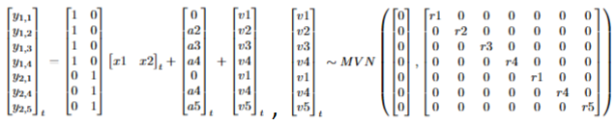
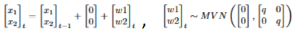
Modeling approach
Specifying matrices properly is crucial

Slide 71
Modeling approach
Specifying matrices properly is crucial
A reference method must be chosen to estimate bias

